Slide 1

STATA crash course
February 7, 9, 14 & 16
Universitat Autònoma de Barcelona
Marc Guinjoan
Universitat Oberta de Catalunya
mguinjoanc@uoc.edu

Slide 2

Departing point: Why Stata?
Statistical software with statistical language
Mostly used in polsci
Evolutive and responsive
Huge community
But...
Privative
Less powerful for some statistical purposes

Slide 3
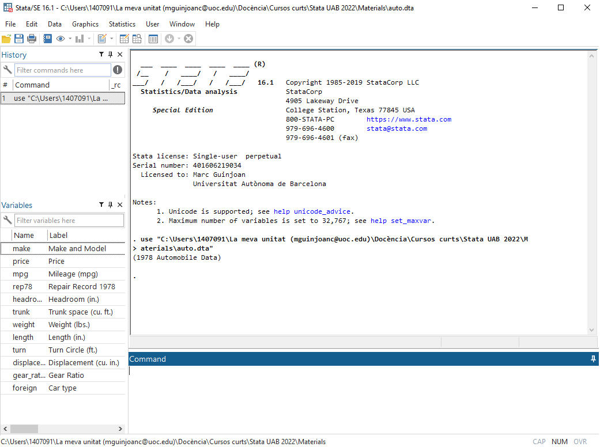
Let’s open Stata
Open syntaxis
Browse database
Data files
.dta
.do
.gph
Open auto.dta
Browse database
Open syntaxis
(past) commands
Output
Variables
(next) command

Slide 4
The syntaxis: the STATA dofile
Why working with a dofile?
Keeping original data
Keep track of changes
Editing of previous decisions
Faster
Handle complex code
Good advices for managing the dofile:
Make it replicable throughout
Explain steps you are taking
*Explanation
/* Long
explanation*/
Running code // explanation (Stata will not attempt to run it)

Slide 5
Let’s start using our own dofile
Open dofile_crashcourse.do
We will continue working from there! ☺

